Slide 1
Credit Risk Analysis
Using Microsoft Excel

Slide 2
Project Description
The objective of the project is to perform Exploratory Data Analysis (EDA) on loan application data to uncover insights about customer and loan attributes that influence the likelihood of default. These findings will help the business in making data-driven decisions—whether to approve, reject, or modify loan terms.
The project involved handling missing data, identifying outliers, analyzing class imbalance, and studying relationships between variables, especially for customers with payment difficulties.

Slide 3
Approach to the Project
In this project, we’ve followed a structured and analytical approach to break down the problem and derive meaningful insights, leveraging Microsoft excel.
Data Cleaning: Identified and handled missing values using Excel functions (ISBLANK, IF, AVERAGE, MEDIAN), and visualized them using bar charts.
Outlier Detection: Used IQR method (QUARTILE, IF) and conditional formatting to detect and highlight outliers; visualized using box plots.
Data Imbalance Analysis: Assessed distribution of default vs non-default cases using COUNTIF; displayed results using pie and bar charts.
EDA (Univariate, Segmented Univariate & Bivariate): Explored individual and combined variable patterns using pivot tables, histograms, and scatter plots—segmented by default status.
Correlation Analysis: Segmented data into defaulters and others, used CORREL to find top influencing variables; visualized through heatmaps.

Slide 4
Tech-Stack Used
Microsoft Excel
Data Cleaning (handling missing values, outliers detection)
Data Analysis (formulas, pivot tables, conditional formatting)
Data Visualization (charts: bar, pie, histogram, pareto chart)
Microsoft PowerPoint
Presentation of insights and findings
Visual storytelling using charts, bullet points, and structured layout

Slide 5
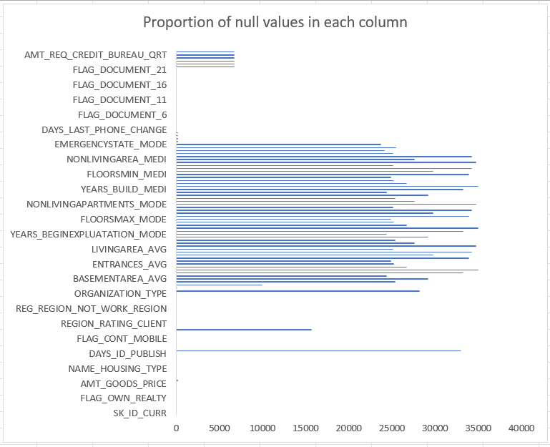
Data Cleaning Task
This graph tells us the proportion of null values in each column of the dataset.
We’ve calculated the null values using the COUNTBLANK function in excel.
For columns like AMT_ANNUITY we’ve imputed the mean value in place of a blank.

Slide 6
Data Cleaning Task
As a part of our data cleaning task, we’ve changed the data type of column AMT_GOODS_PRICE to numeric, which was earlier of text data type.
To perform further analysis, we needed customer age and employment duration in years. So, we converted the respective columns from days to years using the formula =ROUND(ABS(Y5)/365, 1).
In the "Days Employed" column, we identified unrealistic values (e.g., over 1000 years of employment). These were marked as "Not Valid" to prevent distortion in the analysis.

Slide 7
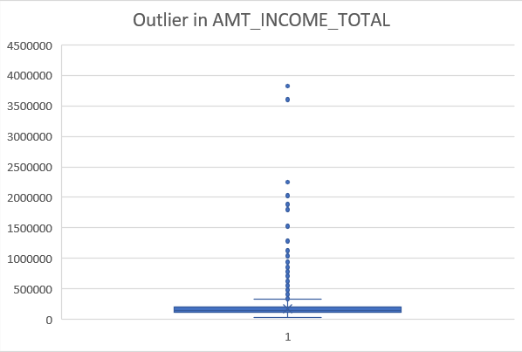
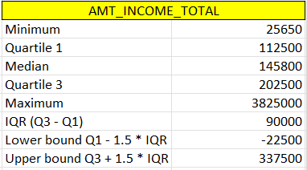
Outlier Detection (Descriptive Statistics & IQR Calculation for Income)
We observed extreme values in applicant income, with the upper bound for normal income being ₹337,500. Any value above this is treated as an outlier. These outliers may represent high-income individuals or data errors and require further investigation.

Slide 8
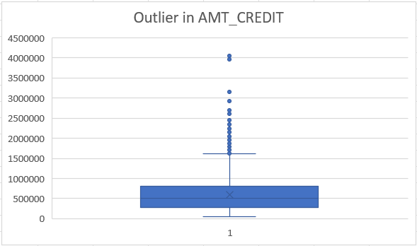
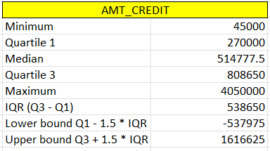
Outlier Detection (Descriptive Statistics & IQR Calculation for Loan Amount)
For the AMT_CREDIT variable (loan amount), the upper bound for detecting outliers is ₹1,616,625. Any loan amount above this threshold is considered an outlier. These extreme values may represent high loan approvals or potential data quality issues and should be further reviewed before modeling.

Slide 9
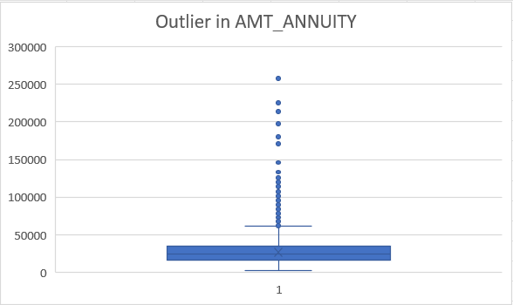
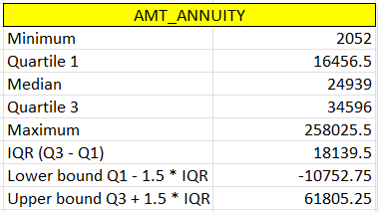
Outlier Detection (IQR-Based Detection for AMT_ANNUITY)
For the AMT_ANNUITY variable (loan repayment amount), values above ₹61,805 are considered outliers. These unusually high annuities could indicate either bulk repayments or data quality issues and require further investigation before analysis.

Slide 10
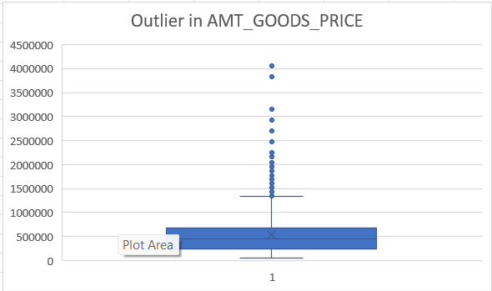
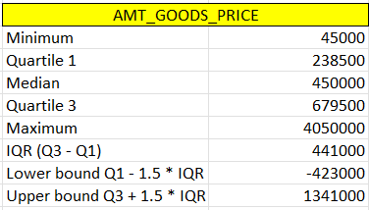
Outlier Detection (Descriptive Statistics & IQR Calculation for Goods Price)
Using IQR-based detection, any AMT_GOODS_PRICE above ₹13,41,000 is flagged as an outlier. These high asset prices may indicate luxury purchases, bulk orders, or incorrect entries.

Slide 11
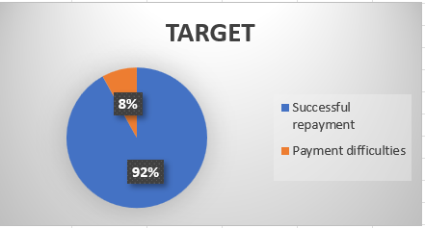
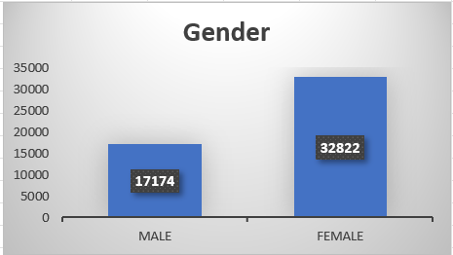
Data Imbalance
What does Data imbalance means?
Data imbalance refers to a situation where the classes in your target variable are not represented equally.
In both visuals, we observe a significant data imbalance. The target variable shows a 92:8 ratio, indicating that a large majority of individuals successfully repay their loans. Additionally, the gender distribution reveals that 66% of the customers are female, while only 34% are male.
Business Insights:
High Repayment Rate(92%) A large majority of customers successfully repay their loans, indicating low credit risk across the current customer base.
Gender Distribution Imbalance 66% of customers are female and only 34% are male. This could reflect targeted marketing, product alignment, or socio-economic trends favoring women borrowers.

Slide 12
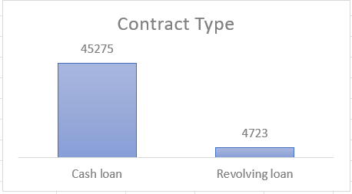
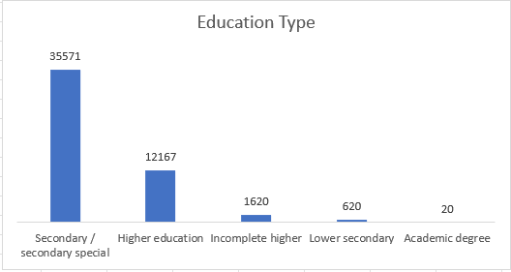
Data Imbalance
There is a significant imbalance in the types of contracts. The dataset is heavily skewed toward cash loans (91%), which could potentially lead to model underperformance on revolving loan predictions unless the imbalance is addressed during model training.
Approximately 69% of the customers have Secondary/Special education, followed by 24.33% with Higher Education, making up over 93% of the total. This heavy concentration in two education levels introduces a bias, which can affect the model’s ability to accurately generalize predictions for underrepresented education groups such as “Lower secondary” or “Academic degree.”
For further visual representations of other variables, you can refer to the complete analysis here:

Slide 13
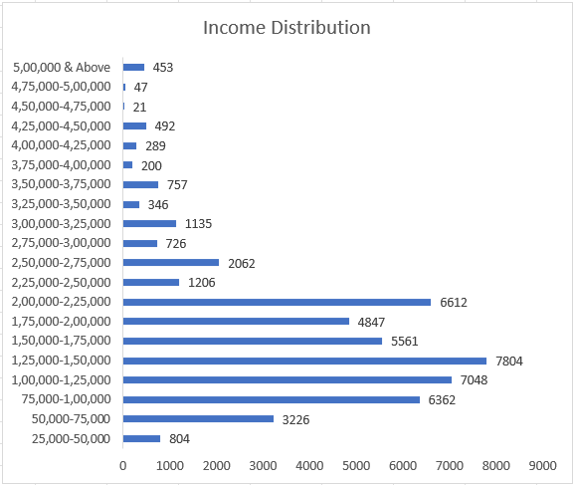
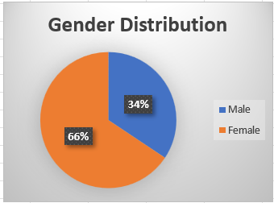
EDA (Univariate Analysis)
Key Insights :-
Majority of customers fall into the range of 75k to 150k (21,214 out of 50,000) per annum.
High-income groups (above ₹5L) are very rare (covering less than 1% of total).
Distribution is skewed toward middle-income groups (₹75,000–₹2,25,000), covering most of the dataset.
Gender distribution is skewed towards female having a share of 66% in the total population.

Slide 14
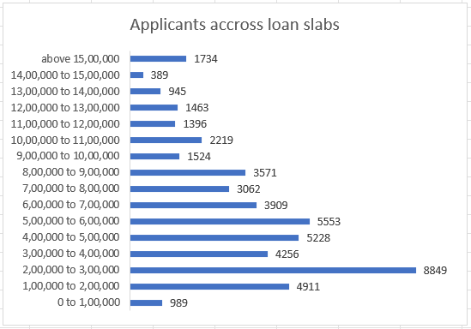
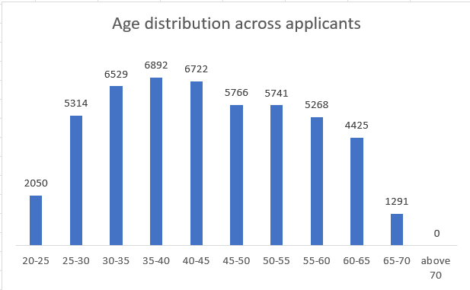
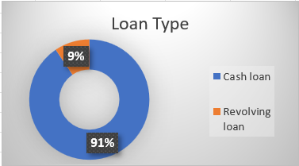
EDA (Univariate Analysis)
Key insights:-
The majority of applicants fall into the ₹2L – ₹3L slab (8,849 applicants), followed by ₹1L – ₹2L and ₹4L – ₹5L.
Most applicants are in the 30–45 age group, with peak density between 30–40 years, suggesting prime borrowing age.
A large majority (91%) of loans are Cash Loans, while only 9% are Revolving Loans, indicating a strong preference for fixed-term borrowing over open-ended credit.

Slide 15
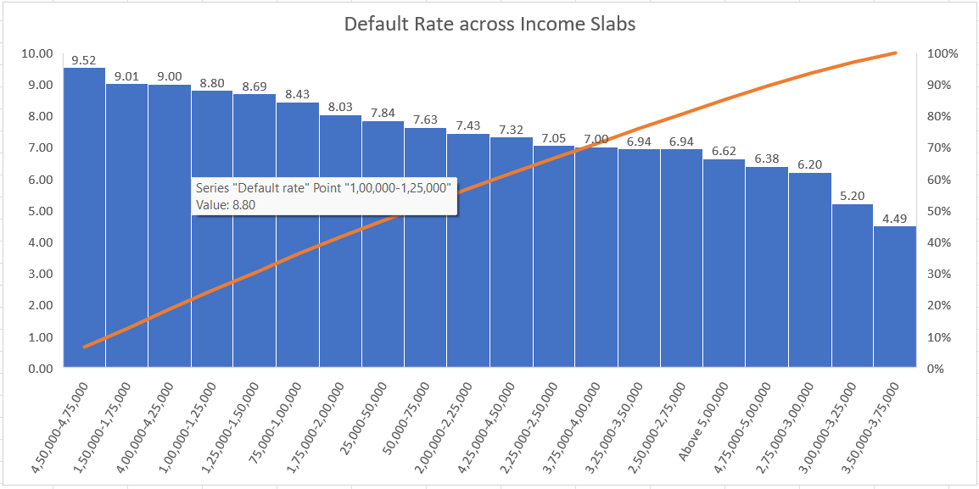
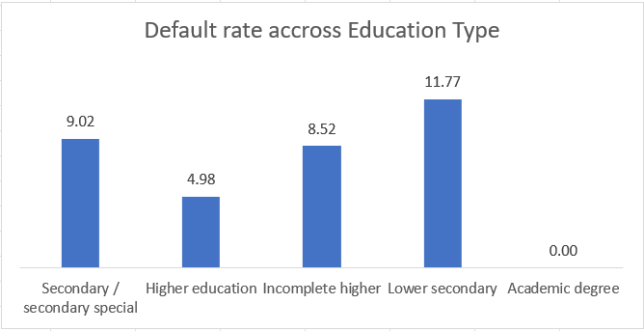
EDA (Segmented Univariate Analysis)
Key insights:-
Default rate is inversely related to income as income increases, default rate decreases.
Individuals earning ₹45,000–₹75,000 have the highest default rate (9.52%).
Those with income above ₹3,50,000 show the lowest default rate (4.49%)
Borrowers with Lower secondary education show the highest default rate (11.77%), making them a high-risk group.
Higher education correlates with lower default risk, aligning with the assumption that more educated individuals may have better jobs or financial planning.

Slide 16
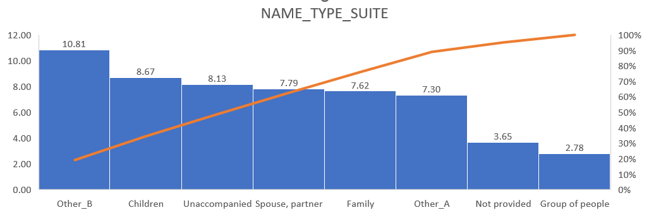
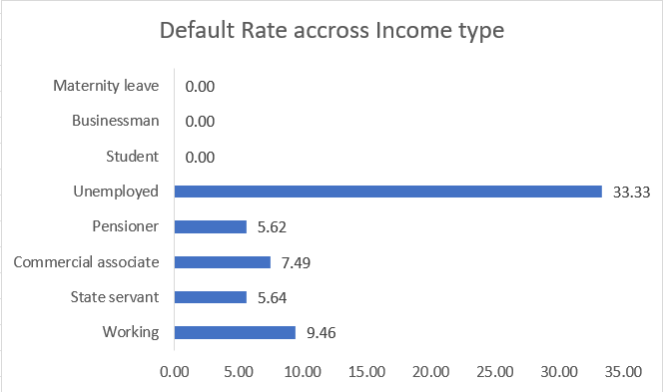
EDA (Segmented Univariate Analysis)
Applicants who selected “Other_B” as their companion have the highest default rate (10.81%).
Unemployed applicants show a significantly high default rate of 33.33%, indicating a clear risk factor.

Slide 17
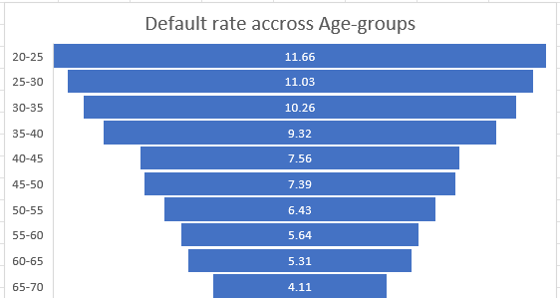
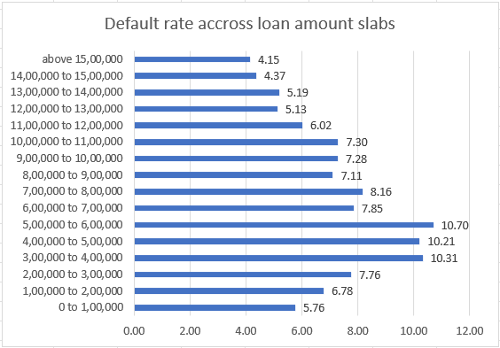
EDA (Segmented Univariate Analysis)
Key insights:-
Young borrowers (20–25) have the highest default rate (11.66%), followed by 25–30 (11.03%), 30–35 (10.26%). Borrowers aged 65–70 have the lowest default rate (4.11%). This suggests younger borrowers are more likely to default.
Default rate is highest for mid-range loans:
₹2,00,000–₹3,00,000: 10.21%
₹3,00,000–₹4,00,000: 10.31%
₹5,00,000–₹6,00,000: 10.70%
Inverted U-shaped pattern: Default rate rises in mid-loan segments, then drops at higher loan amounts.

Slide 18
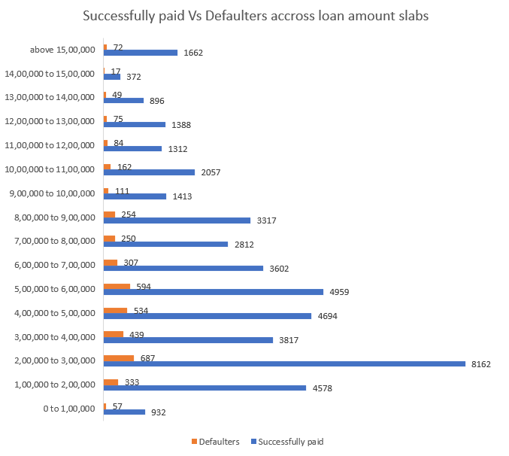
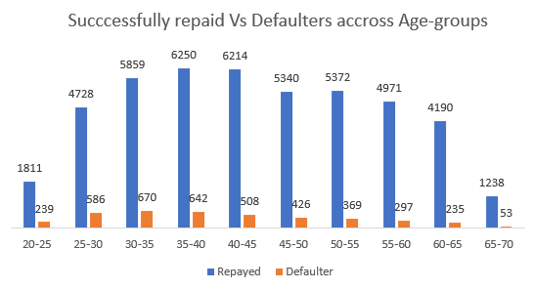
EDA (Bivariate Analysis)
Key insights:-
Loan Amount vs Defaulting Behavior
Default rates peak in the mid-range slabs (₹2L–₹6L), especially ₹3L–₹6L where defaults are both high in number and proportion.
Higher loan slabs (>₹10L) show better repayment behavior.
This could indicate stricter credit screening or more financially stable applicants in higher slabs.
Age Group vs Defaulting Behavior
The age group 30–45 shows highest number of loans disbursed and repaid indicating they are the most active and reliable borrowers.
Younger applicants (20–25) and older age group (65–70) have higher relative default rates, despite fewer total loans.

Slide 19
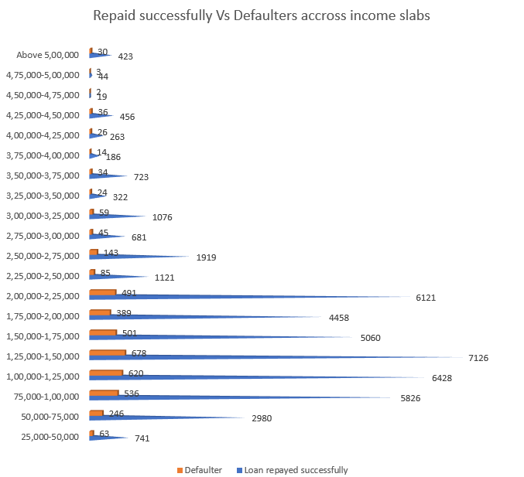
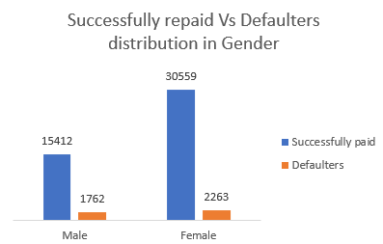
EDA (Bivariate Analysis)
Key insights:-
Income Slab vs Defaulting Behavior
Mid-income groups (₹50K – ₹2.5L) show higher numbers of both repayment and default.
In contrast, very high-income slabs (₹>5L) show minimal defaulting.
Applicants in the mid-income range are more vulnerable to default.
Gender vs Defaulting Behavior
Females account for a significantly larger number of loans compared to males.
Although women constitute the majority of borrowers, men have a higher default rate, indicating women are relatively more reliable borrowers in this dataset.

Slide 20
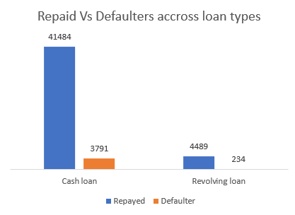
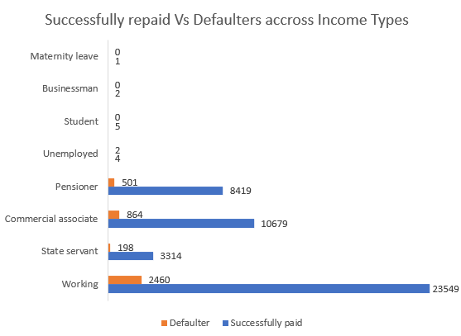
EDA (Bivariate Analysis)
Key Insights:-
Loan Type Vs Default behavior
Cash Loans are significantly more common than Revolving Loans. There is also a proportionally higher number of defaulters compared to revolving loans. Hence, Loan type has a relationship with repayment behavior.
Income Type Vs Default behavior
Most loans are taken by the "Working" class, followed by Commercial associates and Pensioners, consolidating to almost 93% of the dataset.
Defaulters are more common among Working and Commercial associates with default rate of 9.46% & 7.50% respectively.

Slide 21
Summary & Key Recommendations
This project focused on performing comprehensive Exploratory Data Analysis (EDA) on a bank’s loan application dataset using Microsoft Excel. Through-out the project we’ve addressed data quality issues through cleaning (handling nulls, invalid entries, and data type corrections).
Detected and flagged outliers in key numeric fields such as income, loan amount, annuity, and goods price.
Identified significant class imbalance in target variable (92% repaid vs 8% defaulted), loan type, gender, and education.
Uncovered key patterns through univariate, segmented, and bivariate analyses highlighting variables linked to loan defaults.

Slide 22
Summary & Key Recommendations
Key recommendations :-
Refine Credit Screening Criteria: Pay closer attention to applicants earning between ₹45K–₹75K, aged 20–35, or with Lower Secondary education, as they show higher default rates.
Use Income Type in Risk Assessment: Applicants from Working and Commercial associate groups have higher default proportions. Consider assigning higher risk weights or stricter approval rules for these segments.
Address Class Imbalance: Use stratified sampling or resampling techniques during model development to avoid biased predictions.
Differentiate Loan Policies by Type: Cash loans have significantly higher default rates than Revolving loans. Tailor credit terms, approval conditions, or interest rates based on loan type.
Target Reliable Segments for Growth: Focus marketing and product offers on Pensioners, State Servants, and females, as they have shown lower default tendencies.
Investigate High Outlier Values: Extremely high values in income, credit amount, and annuity should be reviewed or excluded before modeling to improve accuracy.

Slide 23
Thank You
You can access the complete Excel workbook here: Bank loan case study (csv).xlsx

